Slide 1
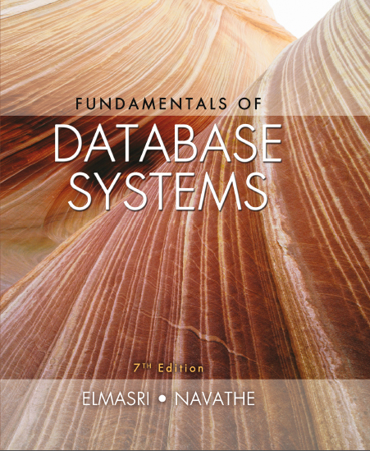
Fundamentals of Database Systems
Seventh Edition
Chapter 17
Indexing Structures for Files and Physical Database Design
Copyright © 2016, 2011, 2007 Pearson Education, Inc. All Rights Reserved
Notes:
If this PowerPoint presentation contains mathematical equations, you may need to check that your computer has the following installed:
1) MathType Plugin
2) Math Player (free versions available)
3) NVDA Reader (free versions available)

Slide 2
Introduction
Indexes used to speed up record retrieval in response to certain search conditions
Index structures provide secondary access paths
Any field can be used to create an index
Multiple indexes can be constructed
Most indexes based on ordered files
Tree data structures organize the index

Slide 3
17.1 Types of Single-Level Ordered Indexes (1 of 4)
Ordered index similar to index in a textbook
Indexing field (attribute)
Index stores each value of the index field with list of pointers to all disk blocks that contain records with that field value
Values in index are ordered
Primary index
Specified on the ordering key field of ordered file of records

Slide 4
17.1 Types of Single-Level Ordered Indexes (2 of 4)
Clustering index
Used if numerous records can have the same value for the ordering field
Secondary index
Can be specified on any nonordering field
Data file can have several secondary indexes

Slide 5
Primary Indexes (1 of 3)
Ordered file with two fields
Primary key, K(i)
Pointer to a disk block, P(i)
One index entry in the index file for each block in the data file
Indexes may be dense or sparse
Dense index has an index entry for every search key value in the data file
Sparse index has entries for only some search values

Slide 6
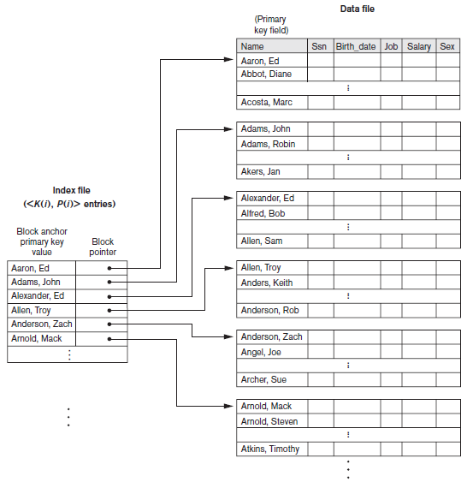
Primary Indexes (2 of 3)
Figure 17.1 Primary index on the ordering key field of the file shown in Figure 16.7

Slide 7
Primary Indexes (3 of 3)
Major problem: insertion and deletion of records
Move records around and change index values
Solutions
Use unordered overflow file
Use linked list of overflow records

Slide 8
Clustering Indexes (1 of 2)
Clustering field
File records are physically ordered on a nonkey field without a distinct value for each record
Ordered file with two fields
Same type as clustering field
Disk block pointer

Slide 9
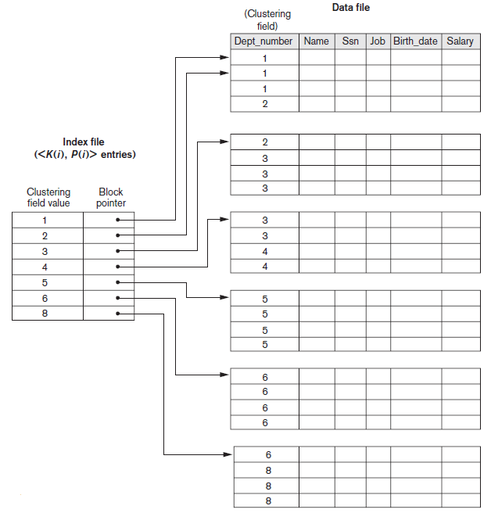
Clustering Indexes (2 of 2)
Figure 17.2 A clustering index on the Dept_number ordering nonkey field of an EMPLOYEE file

Slide 10
Secondary Indexes (1 of 2)
Provide secondary means of accessing a data file
Some primary access exists
Ordered file with two fields
Indexing field, K(i)
Block pointer or record pointer, P(i)
Usually need more storage space and longer search time than primary index
Improved search time for arbitrary record

Slide 11
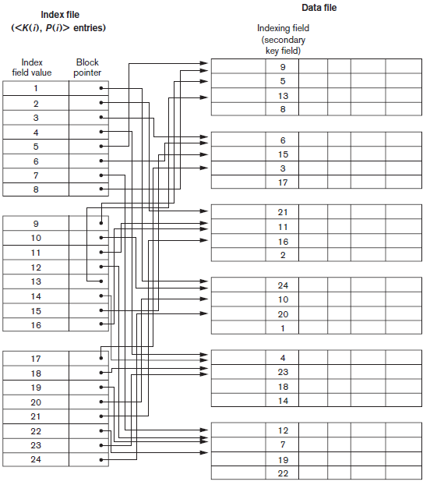
Secondary Indexes (2 of 2)
Figure 17.4 Dense secondary index (with block pointers) on a nonordering key field of a file.

Slide 12
17.1 Types of Single-Level Ordered Indexes (3 of 4)
Table 17.1 Types of indexes based on the properties of the indexing field
Blank | Index Field Used for Physical Ordering of the File | Index Field Not Used for Physical Ordering of the File
Indexing field is key | Primary index | Secondary index (Key)
Indexing field is nonkey | Clustering index | Secondary index (NonKey)

Slide 13
17.1 Types of Single-Level Ordered Indexes (4 of 4)
Table 17.2 Properties of Index Types
Type of Index | Number of (First-Level) Index Entries | Dense or Nondense (Sparse) | Block Anchoring on the Data File
Primary | Number of blocks in data file | Nondense | Yes
Clustering | Number of distinct index field values | Nondense | Yes slash no superscript a
Secondary (key) | Number of records in data file | Dense | No
Secondary (nonkey) | Number of records superscript b or number of distinct index field values superscript c | Dense or Nondense | No
ª Yes if every distinct value of the ordering field starts a new block; no otherwise.
^{b} For option 1.
^{c} For options 2 and 3.

Slide 14
17.2 Multilevel Indexes
Designed to greatly reduce remaining search space as search is conducted
Index file
Considered first (or base level) of a multilevel index
Second level
Primary index to the first level
Third level
Primary index to the second level

Slide 15
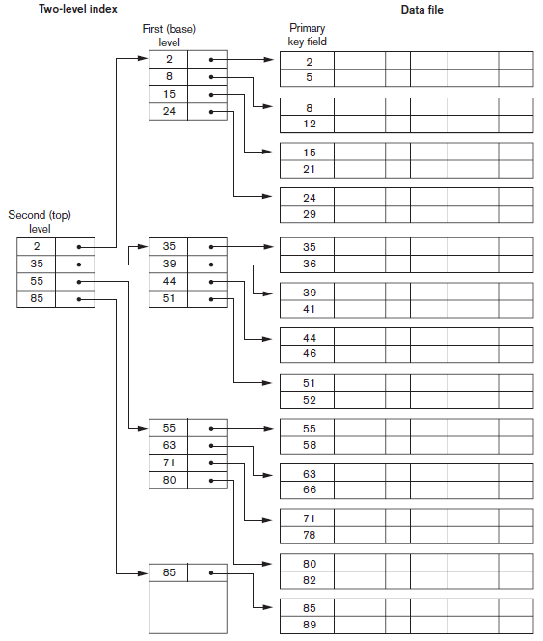
Figure 17.6 A Two-Level Primary Index Resembling I S A M (Indexed Sequential Access Method) Organization

Slide 16
17.3 Dynamic Multilevel Indexes Using B-Trees and B+ -Trees
Tree data structure terminology
Tree is formed of nodes
Each node (except root) has one parent and zero or more child nodes
Leaf node has no child nodes
Unbalanced if leaf nodes occur at different levels
Nonleaf node called internal node
Subtree of node consists of node and all descendant nodes

Slide 17
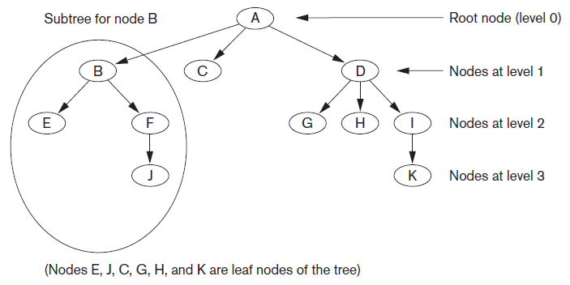
Tree Data Structure
Figure 17.7 A tree data structure that shows an unbalanced tree

Slide 18
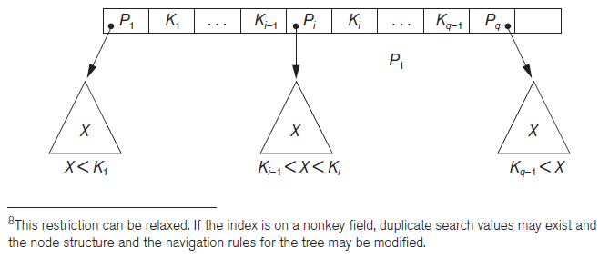
Search Trees and B-Trees (1 of 2)
Search tree used to guide search for a record
Given value of one of record’s fields
Figure 17.8 A node in a search tree with pointers to subtrees below it

Slide 19
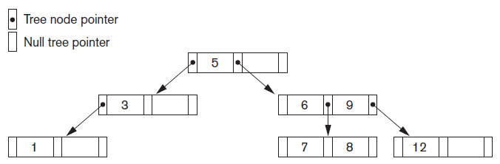
Search Trees and B-Trees (2 of 2)
Algorithms necessary for inserting and deleting search values into and from the tree
Figure 17.9 A search tree of order p = 3

Slide 20
B-Trees
Provide multi-level access structure
Tree is always balanced
Space wasted by deletion never becomes excessive
Each node is at least half-full
Each node in a B-tree of order p can have at most p−1 search values

Slide 21
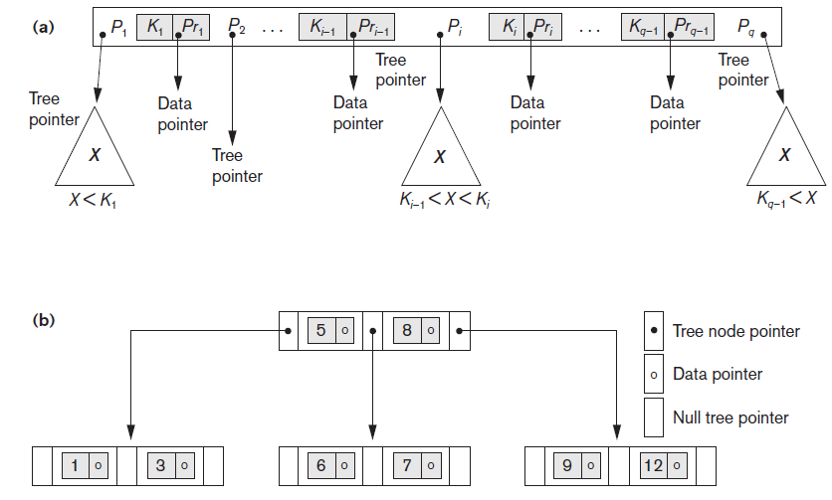
B-Tree Structures
Figure 17.10 B-tree structures (a) A node in a B-tree with q−1 search values (b) A B-tree of order p=3. The values were inserted in the order 8, 5, 1, 7, 3, 12, 9, 6

Slide 22
B+ -Trees (1 of 2)
Data pointers stored only at the leaf nodes
Leaf nodes have an entry for every value of the search field, and a data pointer to the record if search field is a key field
For a nonkey search field, the pointer points to a block containing pointers to the data file records
Internal nodes
Some search field values from the leaf nodes repeated to guide search

Slide 23
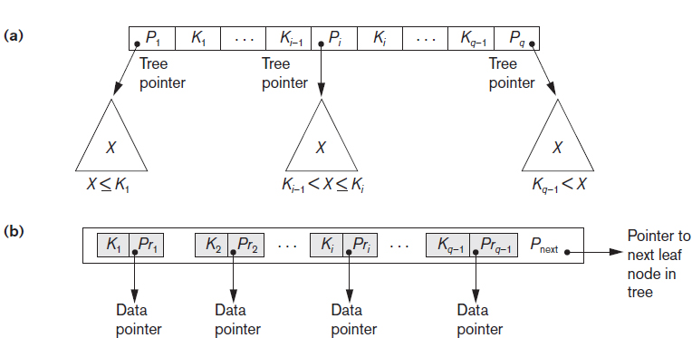
B+ -Trees (2 of 2)
Figure 17.11 The nodes of a B+-tree (a) Internal node of a B+-tree with q−1 search values (b) Leaf node of a B+-tree with q−1 search values and q−1 data pointers

Slide 24
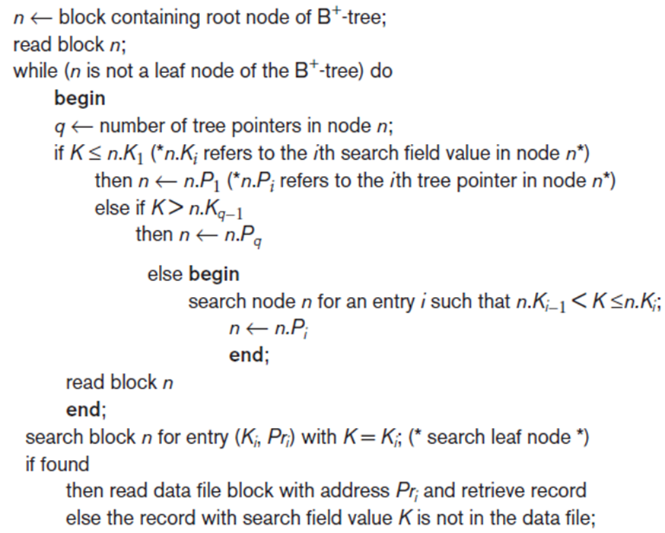
Searching for a Record with Search Key Field Value K, Using a B+ -Tree
Algorithm 17.2 Searching for a record with search key field value K, using a B+ -Tree

Slide 25
17.4 Indexes on Multiple Keys (1 of 2)
Multiple attributes involved in many retrieval and update requests
Composite keys
Access structure using key value that combines attributes
Partitioned hashing
Suitable for equality comparisons

Slide 26
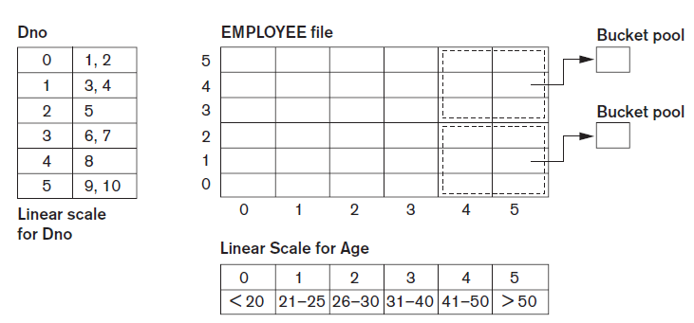
17.4 Indexes on Multiple Keys (2 of 2)
Grid files
Array with one dimension for each search attribute
Figure 17.14 Example of a grid array on Dno and Age attributes

Slide 27
17.5 Other Types of Indexes
Hash indexes
Secondary structure for file access
Uses hashing on a search key other than the one used for the primary data file organization
Index entries of form (K, P_{r}) or (K, P)
P_{r}: pointer to the record containing the key
P: pointer to the block containing the record for that key

Slide 28
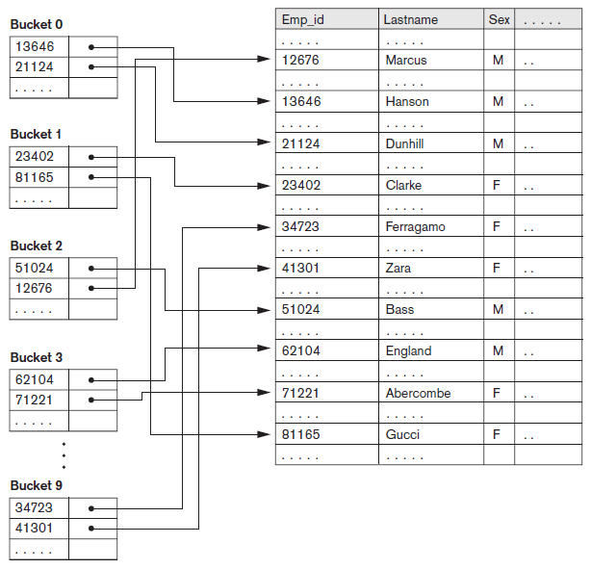
Hash Indexes
Figure 17.15 Hash-based indexing

Slide 29
Bitmap Indexes
Used with a large number of rows
Creates an index for one or more columns
Each value or value range in the column is indexed
Built on one particular value of a particular field
Array of bits
Existence bitmap
Bitmaps for B+ -tree leaf nodes

Slide 30

Function-Based Indexing
Value resulting from applying some function on a field (or fields) becomes the index key
Introduced in Oracle relational D B M S
Example
Function UPPER(Lname) returns uppercase representation
Query

Slide 31
17.6 Some General Issues Concerning Indexing
Physical index
Pointer specifies physical record address
Disadvantage: pointer must be changed if record is moved
Logical index
Used when physical record addresses expected to change frequently
Entries of the form (K, K_{p})

Slide 32

Index Creation
General form of the command to create an index
Unique and cluster keywords optional
Order can be A S C or D E S C
Secondary indexes can be created for any primary record organization
Complements other primary access methods

Slide 33
Indexing of Strings
Strings can be variable length
Strings may be too long, limiting the fan-out
Prefix compression
Stores only the prefix of the search key adequate to distinguish the keys that are being separated and directed to the subtree

Slide 34
Tuning Indexes
Tuning goals
Dynamically evaluate requirements
Reorganize indexes to yield best performance
Reasons for revising initial index choice
Certain queries may take too long to run due to lack of an index
Certain indexes may not get utilized
Certain indexes may undergo too much updating if based on an attribute that undergoes frequent changes

Slide 35
Additional Issues Related to Storage of Relations and Indexes (1 of 2)
Enforcing a key constraint on an attribute
Reject insertion if new record has same key attribute as existing record
Duplicates occur if index is created on a nonkey field
Fully inverted file
Has secondary index on every field
Indexing hints in queries
Suggestions used to expedite query execution

Slide 36
Additional Issues Related to Storage of Relations and Indexes (2 of 2)
Column-based storage of relations
Alternative to traditional way of storing relations by row
Offers advantages for read-only queries
Offers additional freedom in index creation

Slide 37
17.7 Physical Database Design in Relational Databases (1 of 3)
Physical design goals
Create appropriate structure for data in storage
Guarantee good performance
Must know job mix for particular set of database system applications
Analyzing the database queries and transactions
Information about each retrieval query
Information about each update transaction

Slide 38
17.7 Physical Database Design in Relational Databases (2 of 3)
Analyzing the expected frequency of invocation of queries and transactions
Expected frequency of using each attribute as a selection or join attribute
80-20 rule: 80 percent of processing accounted for by only 20 percent of queries and transactions
Analyzing the time constraints of queries and transactions
Selection attributes associated with time constraints are candidates for primary access structures

Slide 39
17.7 Physical Database Design in Relational Databases (3 of 3)
Analyzing the expected frequency of update operations
Minimize number of access paths for a frequently-updated file
Updating the access paths themselves slows down update operations
Analyzing the uniqueness constraints on attributes
Access paths should be specified on all candidate key attributes that are either the primary key of a file or unique attributes

Slide 40
Physical Database Design Decisions
Design decisions about indexing
Whether to index an attribute
Attribute is a key or used by a query
What attribute(s) to index on
Single or multiple
Whether to set up a clustered index
One per table
Whether to use a hash index over a tree index
Hash indexes do not support range queries
Whether to use dynamic hashing
Appropriate for very volatile files

Slide 41
17.8 Summary
Indexes are access structures that improve efficiency of record retrieval from a data file
Ordered single-level index types
Primary, clustering, and secondary
Multilevel indexes can be implemented as B-trees and B+ -trees
Dynamic structures
Multiple key access methods
Logical and physical indexes

Slide 42

Copyright

